Slide 1


Slide 2
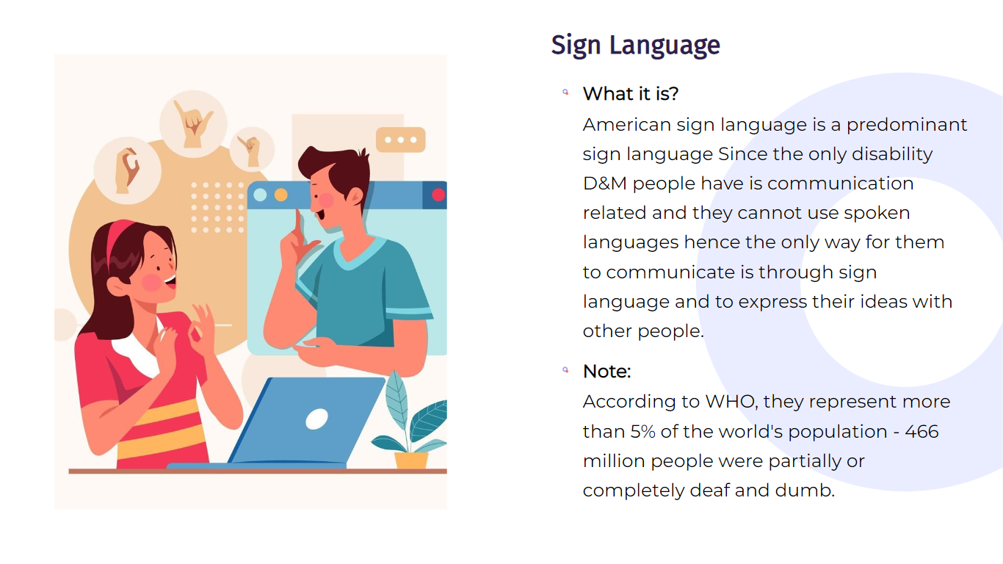
PROBLEM STATEMENT
The sign language to speech convertors are able to convert your sign language/gesture into speech in specific languages , not able to convey it in our regional languages ,When dumb peoples visit Banking sectors, travelling period ,etc.. We identify this problem ,which is given as a problem at "Intellectual and developmental disabilities" which was conducted by Ministry of Social Justice and Empowerment, has joined hands with the All India Council for Technical Education (AICTE).

Slide 3
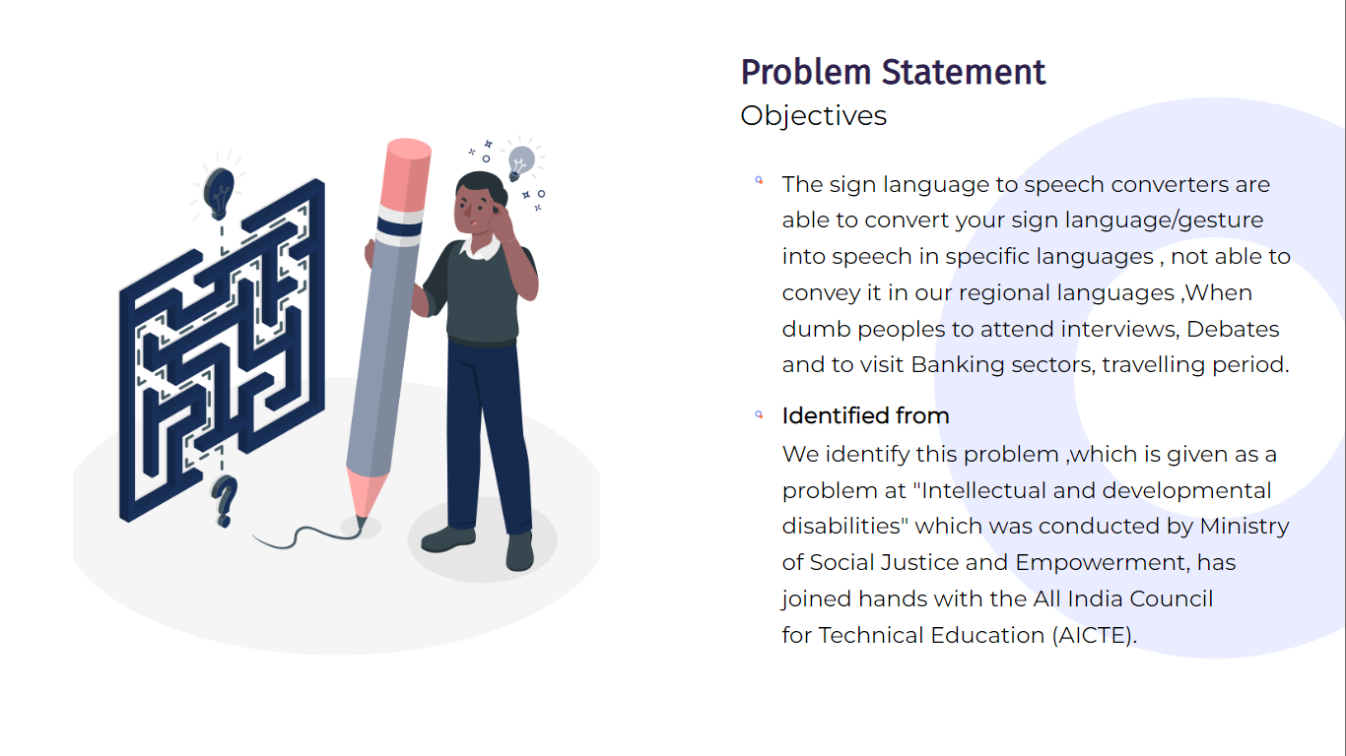
INTRODUCTION
American sign language is a predominant sign language Since the only disability D&M people have is communication related and they cannot use spoken languages hence the only way for them to communicate is through sign language. Deaf and dumb(D&M) people make use of their hands to express different gestures to express their ideas with other people. Gestures are the nonverbally exchanged messages and these gestures are understood with vision. This nonverbal communication of deaf and dumb people is called sign language.

Slide 4
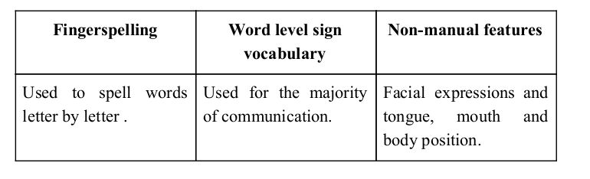
Sign language is a visual language and consists of 3 major
components
In our project we basically focus on producing a model which can identify Fingerspelling based hand gestures in order to form a complete word by combining each gesture. The gestures we aim to train are as given in the Image in the next slide

Slide 5
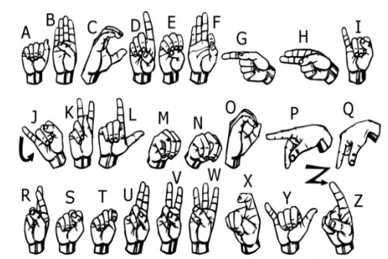
AMERICAN SIGN LANGUAGE:

Slide 6
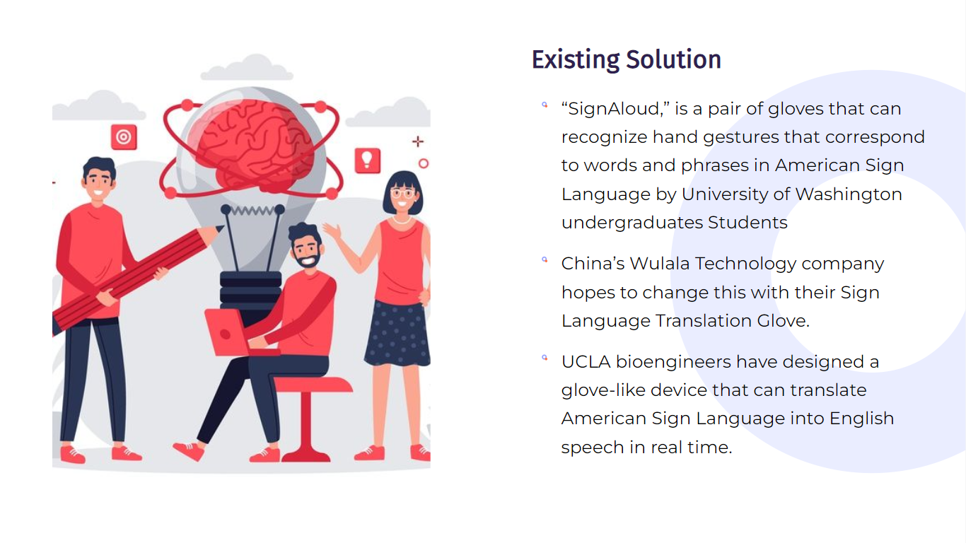

Slide 7
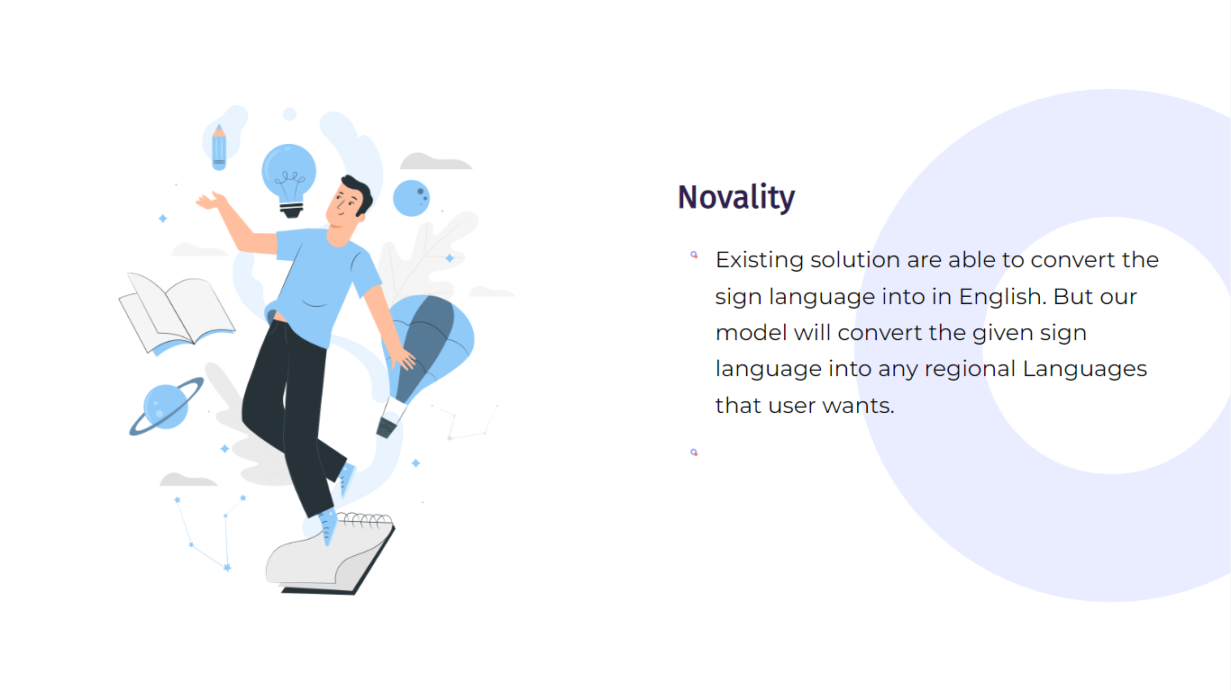

Slide 8
Python 3.6.6​
Tensorflow 1.11.0
OpenCV 3.4.3.18 ​
NumPy 1.15.3 ​
Matplotlib 3.0.0 ​
Hunspell 2.0.2​
Keras 2.2.1 ​
PIL 5.3.0​
SOFTWARE REQUIREMENT:

Slide 9
LIMITATIONS OF OUR MODEL:
The model works well only in good lighting conditions.
Plain background is needed for the model to detect with accuracy.

Slide 10
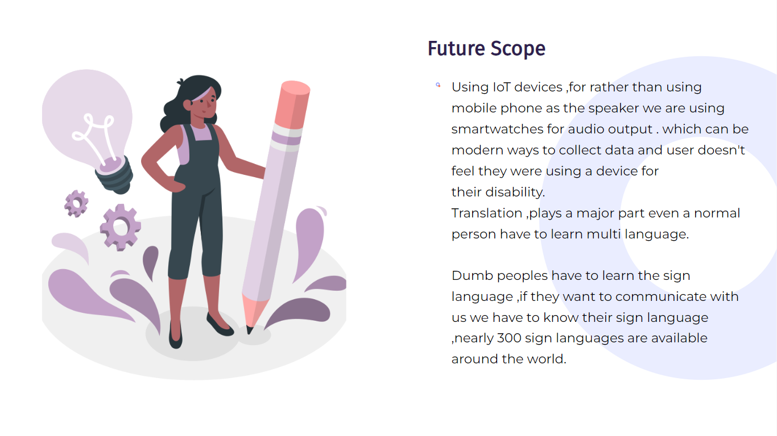

Slide 11
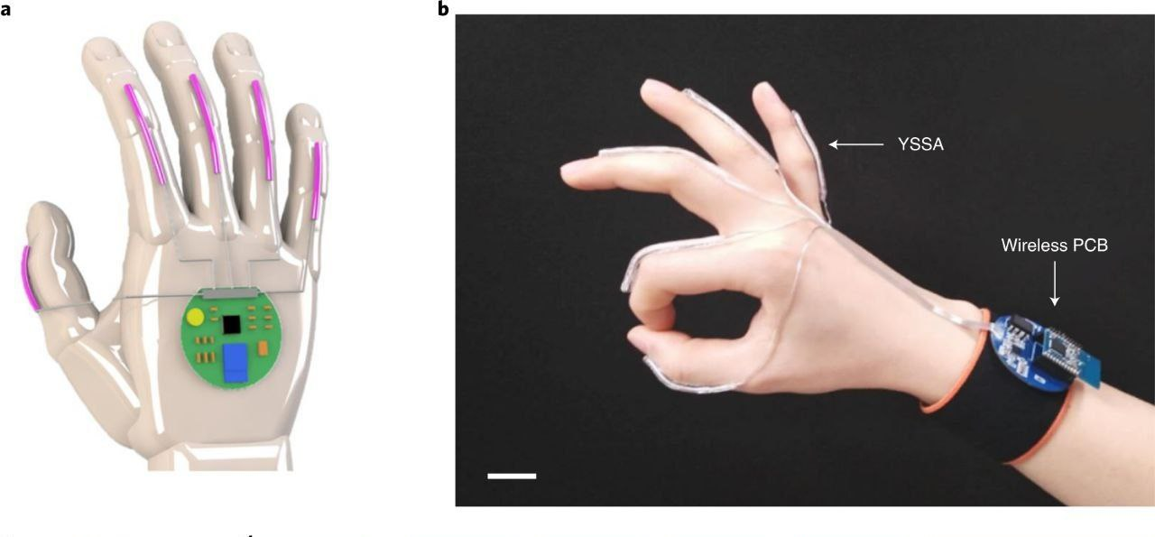

Slide 12
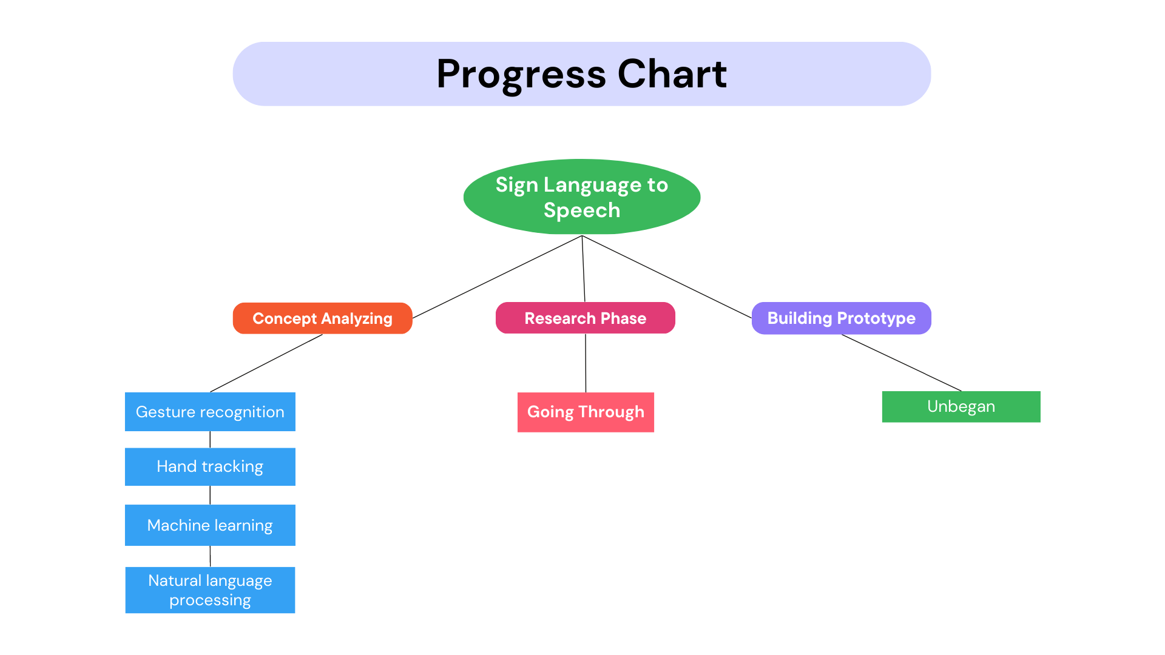
Phase 1(Camera)
Phase2(Gloves)

Slide 13
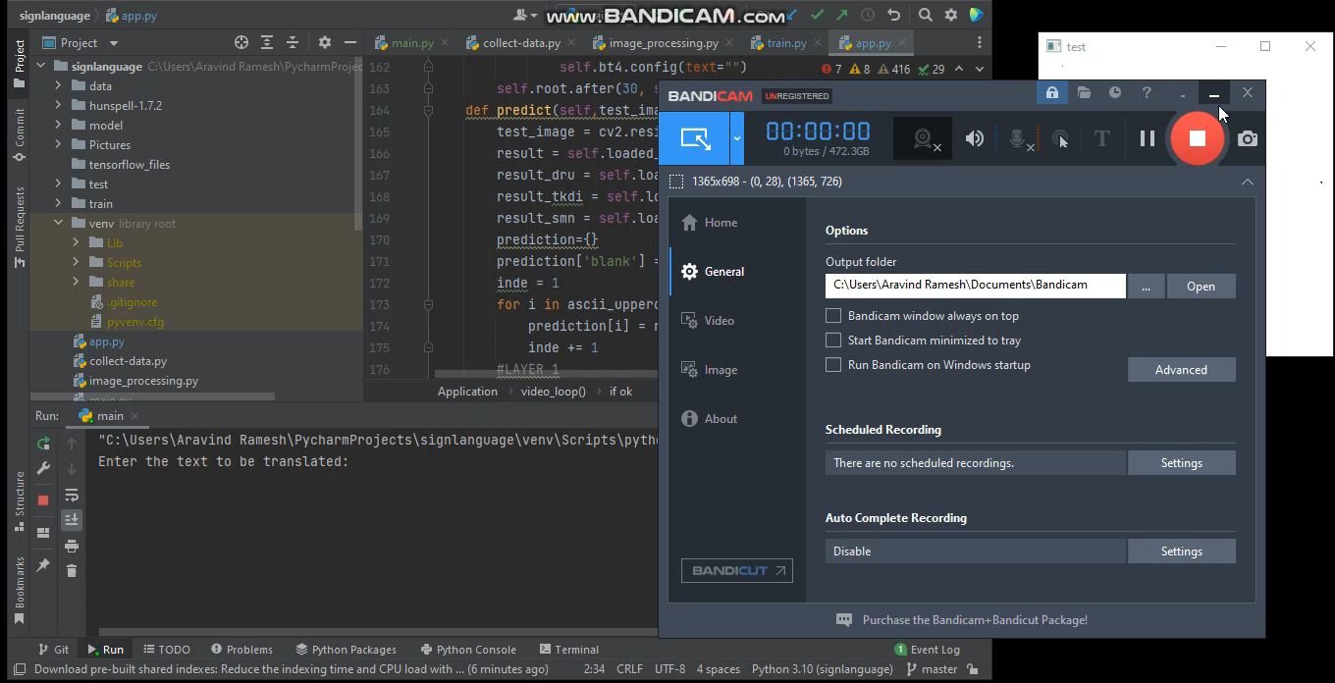

Slide 14
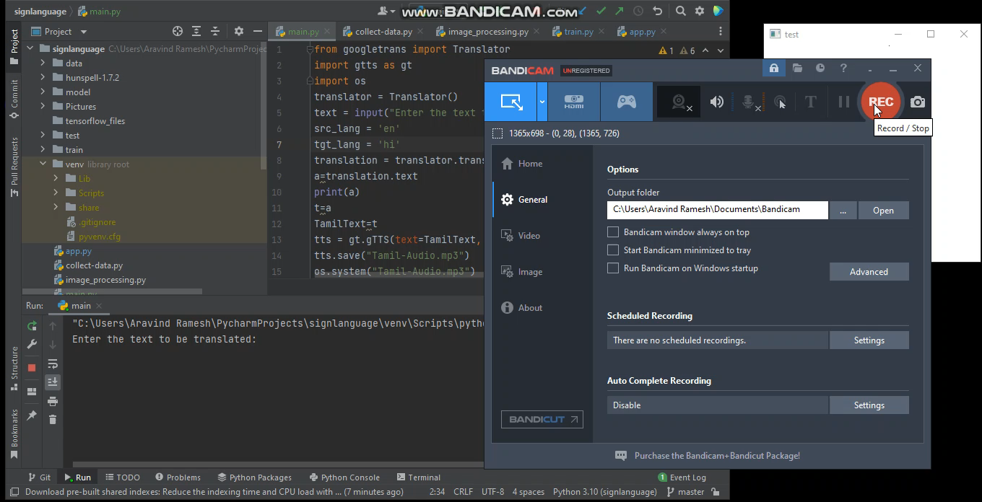

Slide 15
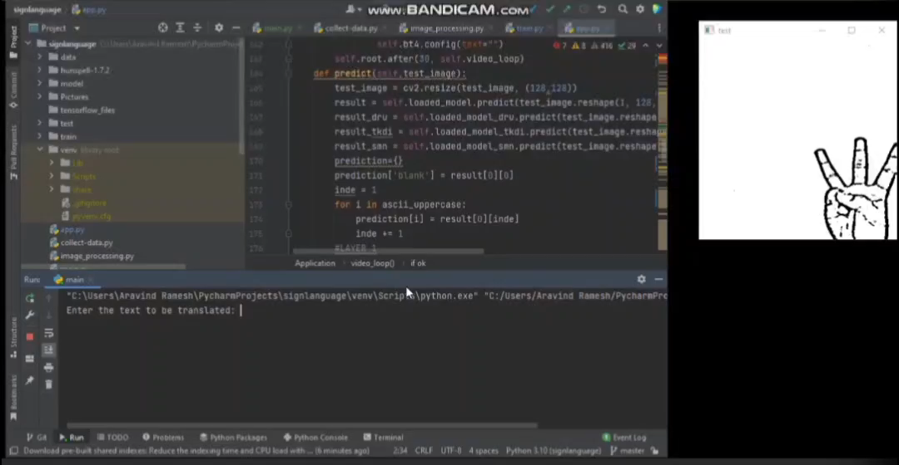

Slide 16
Team name : JIT's ORION
College name: Jansons institute of technology
Team members:
1) Kamesh R
2) Aswin S
3) Yehaasary K M
Email ID:-
kamesh21cs042@jit.ac.in
aswinsomasundaram3@gmail.com
kmyehaa@gmail.com
Contact no:-
Kamesh R :- 9566605171
Aswin S :- 8056677688
Yehaasary K M :- 8148002483

